Slide 1
CIVE 546 Structural Design Optimization (3 units)
Top88: tutorial
Instructor: | Prof. Yi Shao
Winter 2025

Slide 2
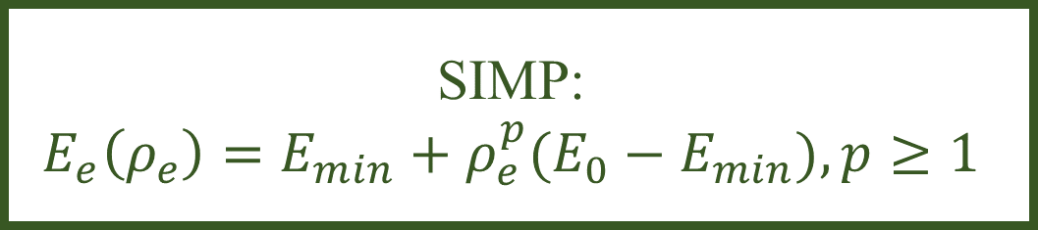
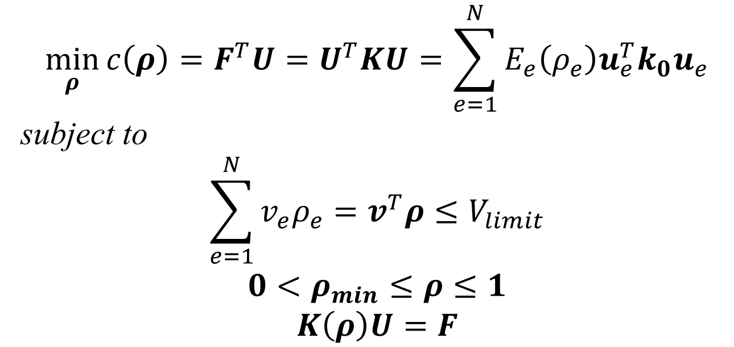
Topology Optimization General Setup for Density Based Approach
$$\min_{ρ}{c\left(ρ\right)=F^{T}U=U^{T}KU=\sum_{e=1}^{N}{E_{e}\left(ρ_{e}\right)u_{e}^{T}k_{0}u_{e}}}$$
subject to
$$\sum_{e=1}^{N}{v_{e}ρ_{e}=v^{T}ρ≤V_{limit}}$$
$$0<ρ_{min}≤ρ≤1$$
$$K\left(ρ\right)U=F$$
SIMP:
$$E_{e}\left(ρ_{e}\right)=E_{min}+ρ_{e}^{p}(E_{0}−E_{min}), p≥1$$

Slide 3
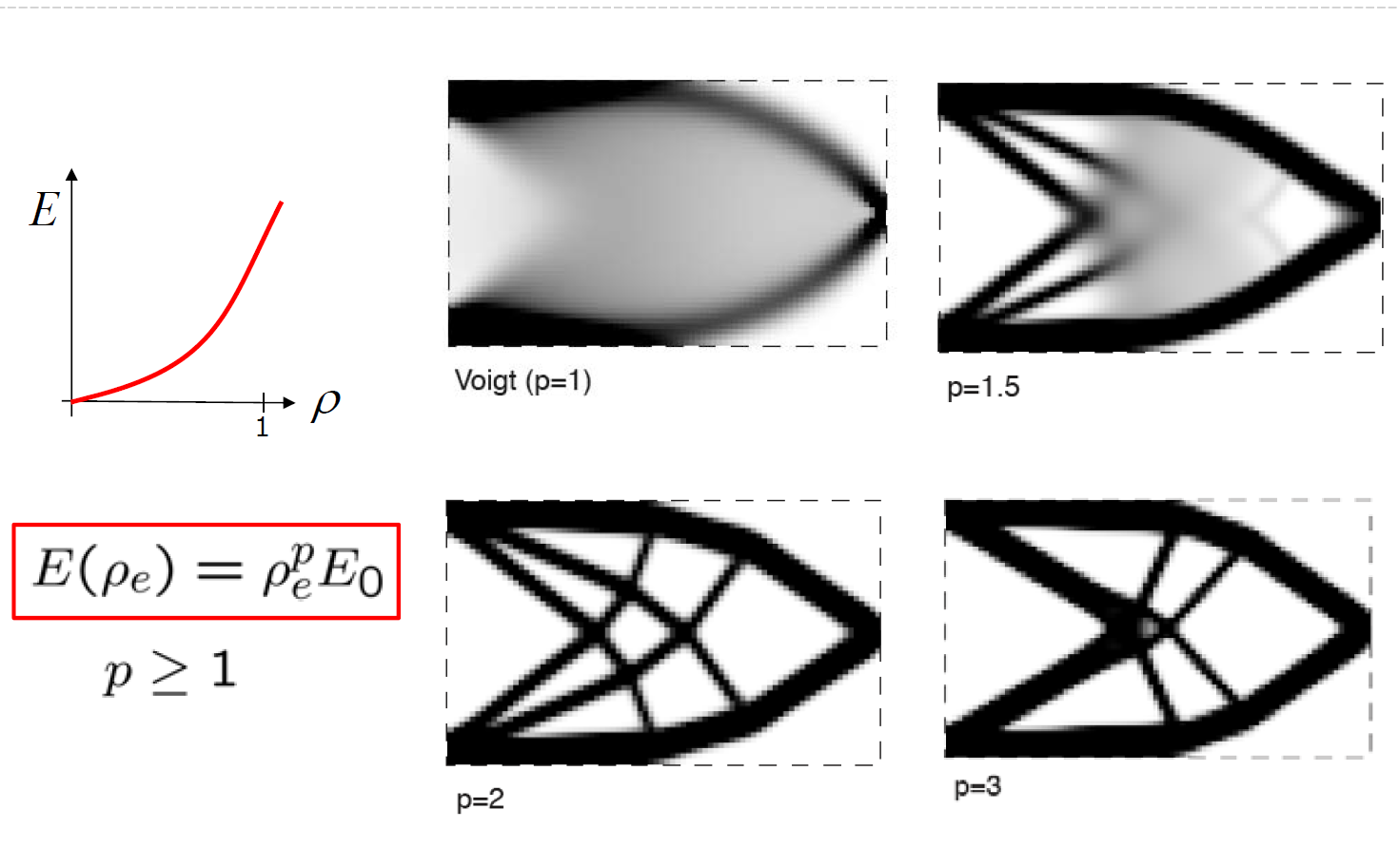

Topology Optimization SIMP
SIMP:
$$E_{e}\left(ρ_{e}\right)=E_{min}+ρ_{e}^{p}\left(E_{0}−E_{min}\right),$$
$$p≥1$$

Slide 4
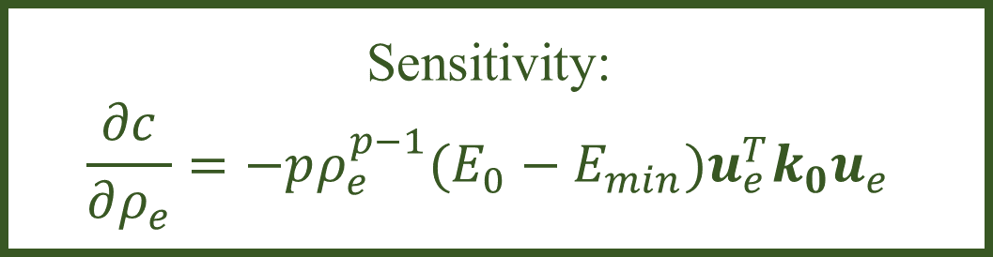
Topology Optimization General Setup for Density Based Approach
$$\min_{ρ}{c\left(ρ\right)=F^{T}U=U^{T}KU=\sum_{e=1}^{N}{E_{e}\left(ρ_{e}\right)u_{e}^{T}k_{0}u_{e}}}$$
subject to
$$\sum_{e=1}^{N}{v_{e}ρ_{e}=v^{T}ρ≤V_{limit}}$$
$$0<ρ_{min}≤ρ≤1$$
$$K\left(ρ\right)U=F$$
Sensitivity:
$$\frac{∂c}{∂ρ_{e}}=−pρ_{e}^{p−1}(E_{0}−E_{min})u_{e}^{T}k_{0}u_{e}$$
SIMP:
$$E_{e}\left(ρ_{e}\right)=E_{min}+ρ_{e}^{p}(E_{0}−E_{min}), p≥1$$

Slide 5
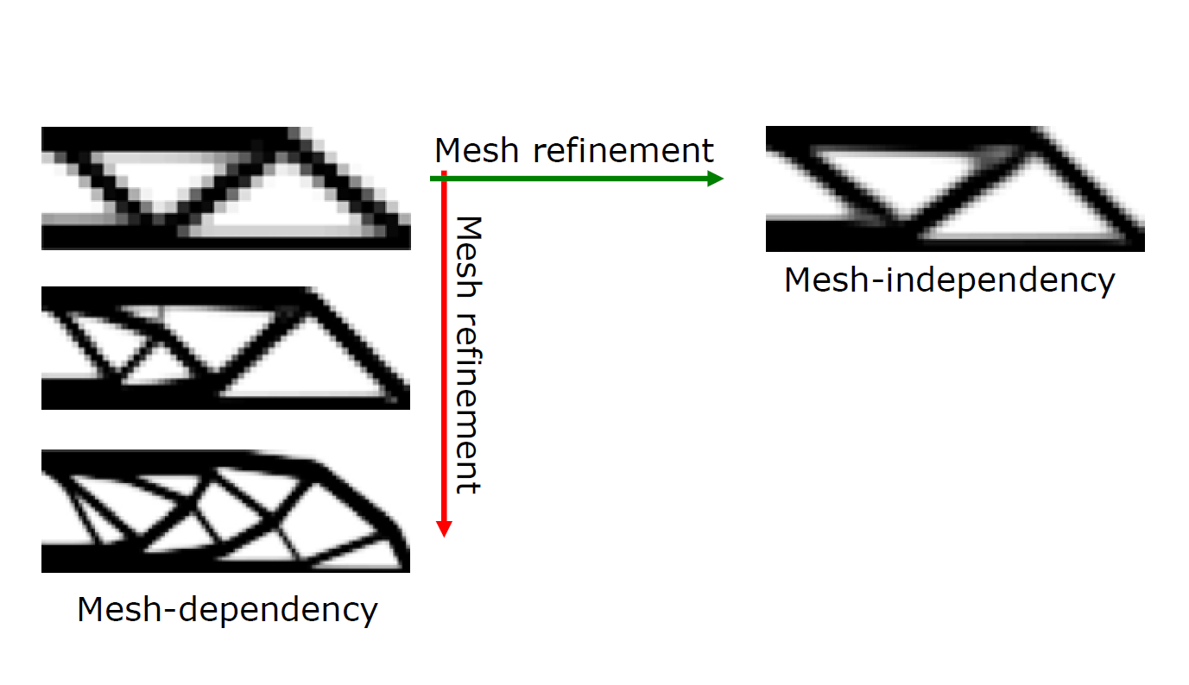
Topology Optimization Mesh dependency?

Slide 6
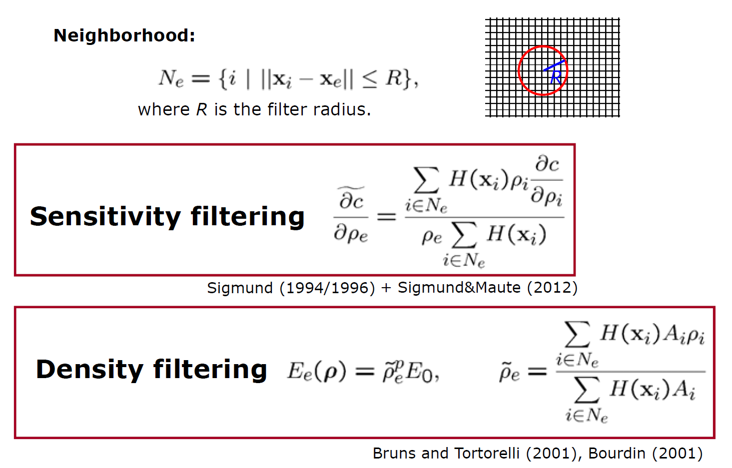
Topology Optimization Mesh independency: filtering technique

Slide 7
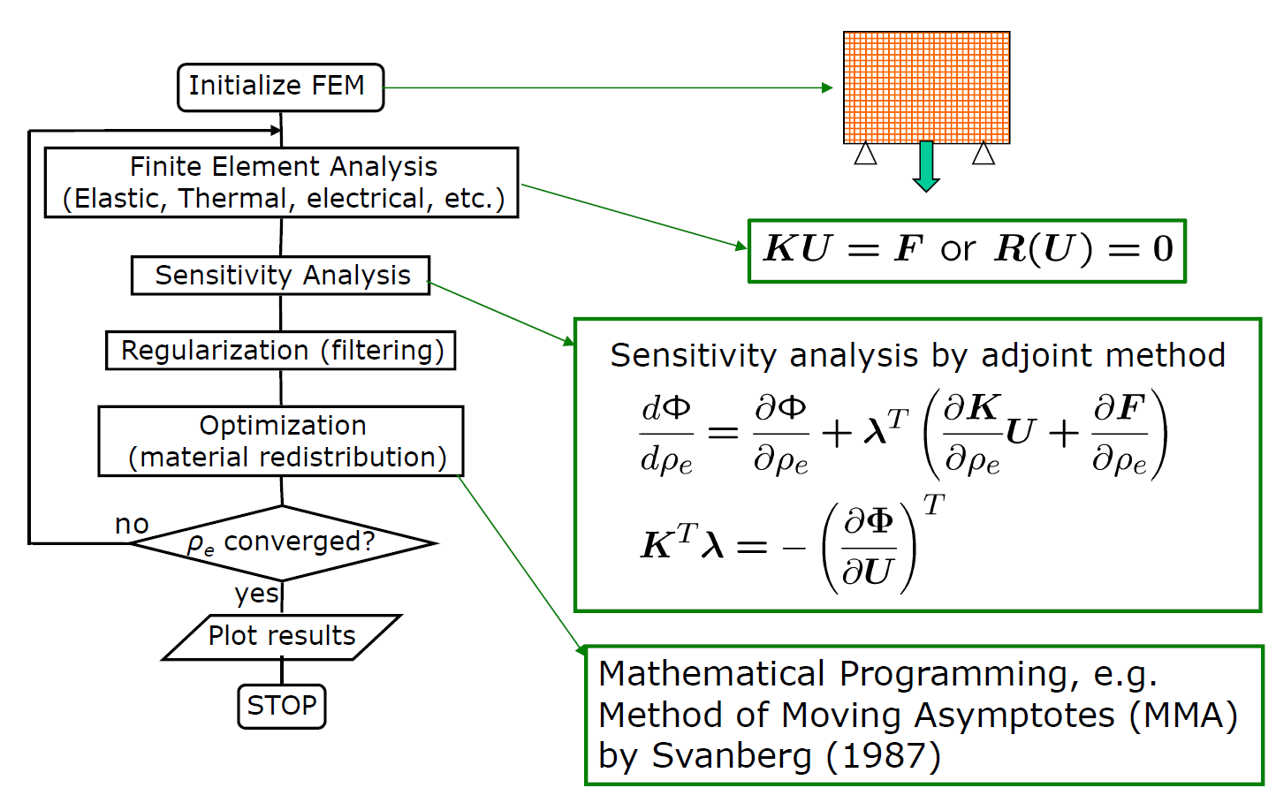

Slide 8
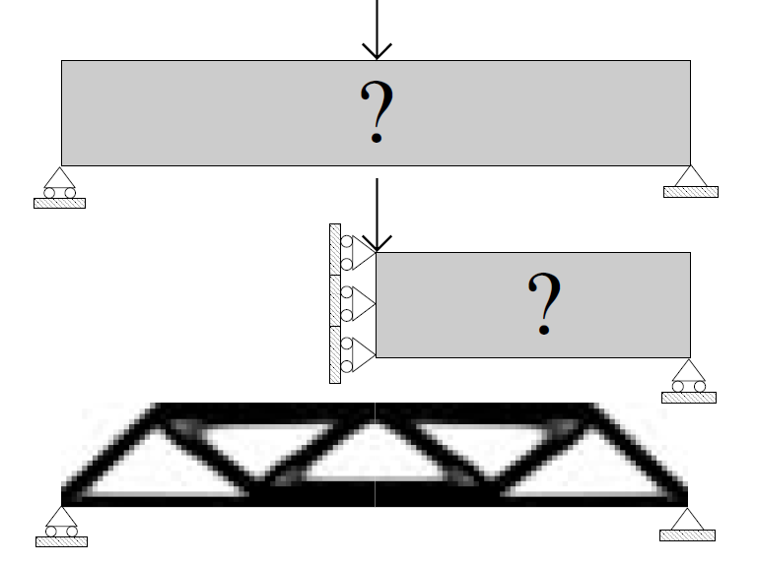
Top88 Default problem

Slide 9
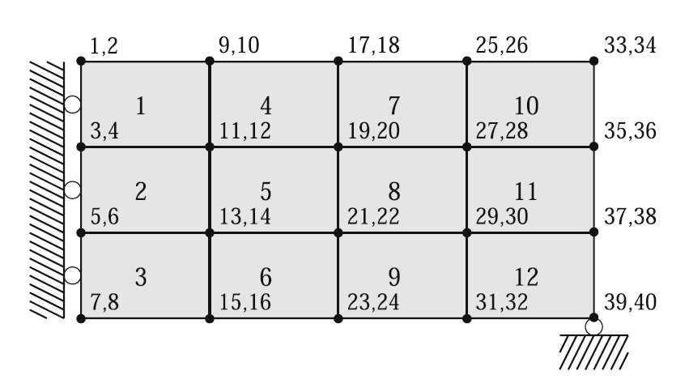
Top88 Mesh

Slide 10

Get your hand dirty!

